Slide 1
Balikesir Meeting, Nov. 2013
COMENIUS PROJECT
NO OTHER WORLD TO LIVE
I.I.S. Gaetano De Sanctis
Rome - Italy
School presentation

Slide 2
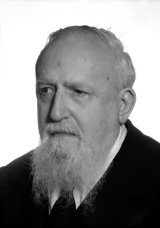
Gaetano De Sanctis High School
Our school was named after Gaetano De Sanctis (1870/1957), outstanding history professor at the University of Turin, who was appointed life senator in 1950. He revolutionized the way we study history by introducing the concept that history is not dead but rather alive and the historian must relive it in order to teach it.

Slide 3
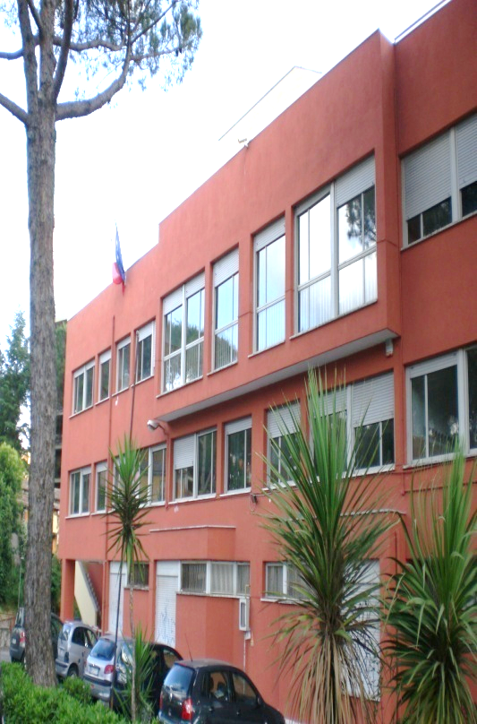
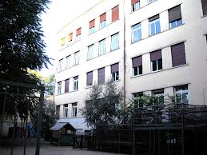
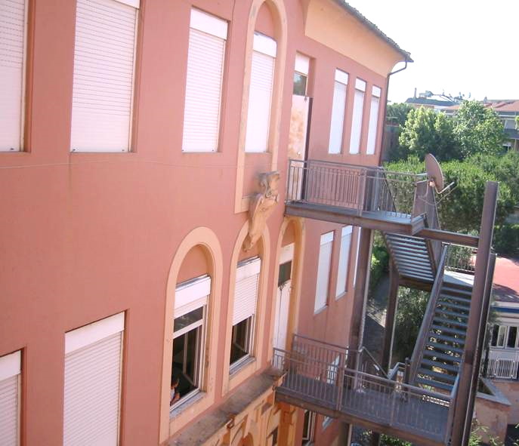
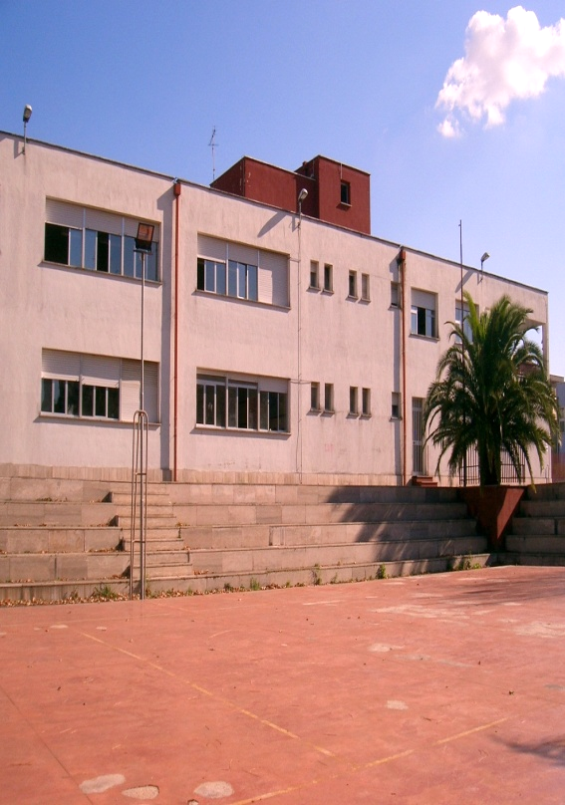
The School Annexes
Via Cassia | Via Malvano | Via Serra | Via Gallina

Slide 4
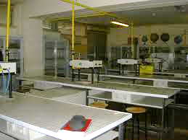
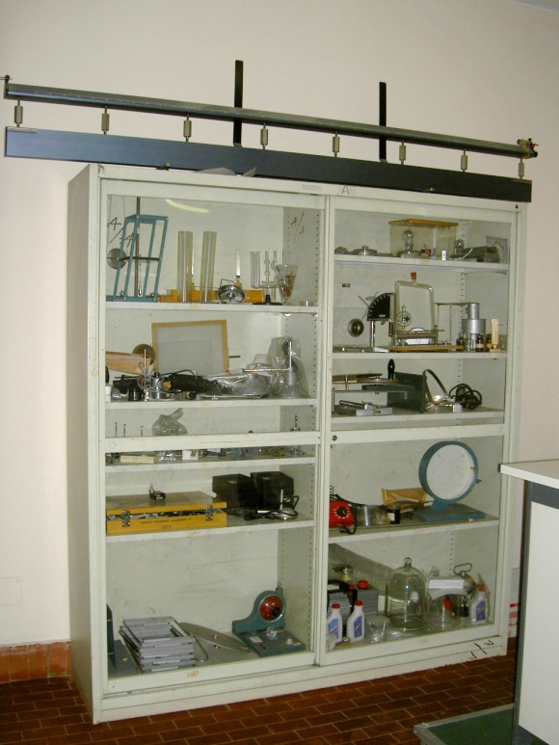
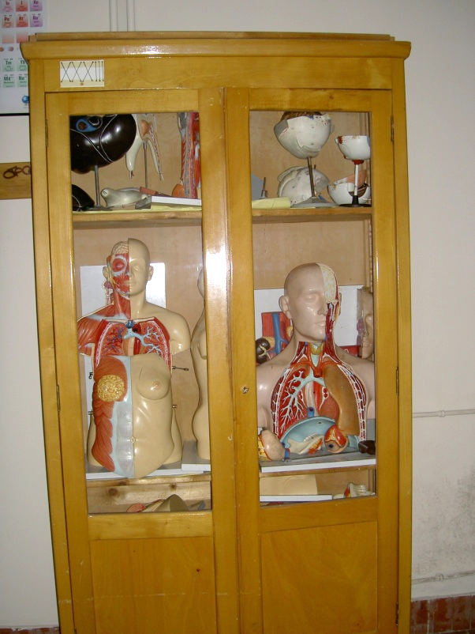
The chemistry lab
The laboratory is supplied with material for experiments in Chemistry, Biology and Earth Sciences. It is equipped with 12 workstations and 4 counters provided with connections to the supply of natural gas, running water and electricity network.

Slide 5
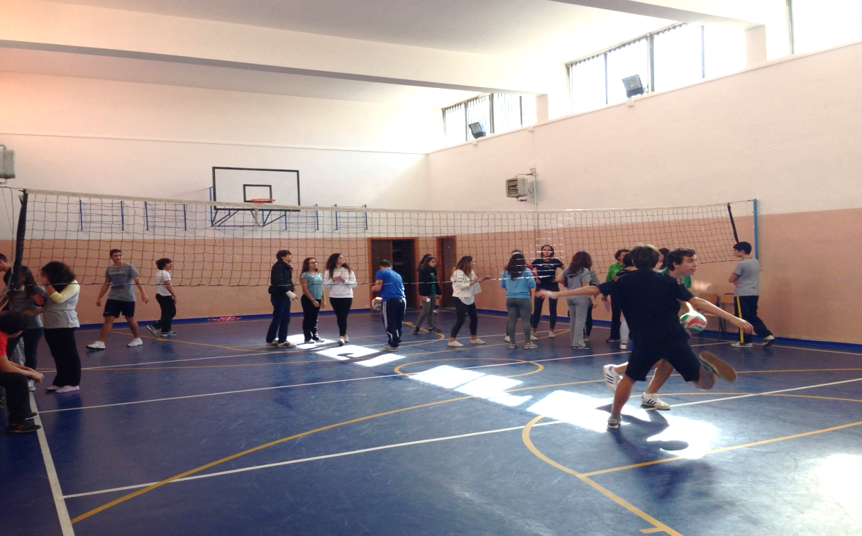
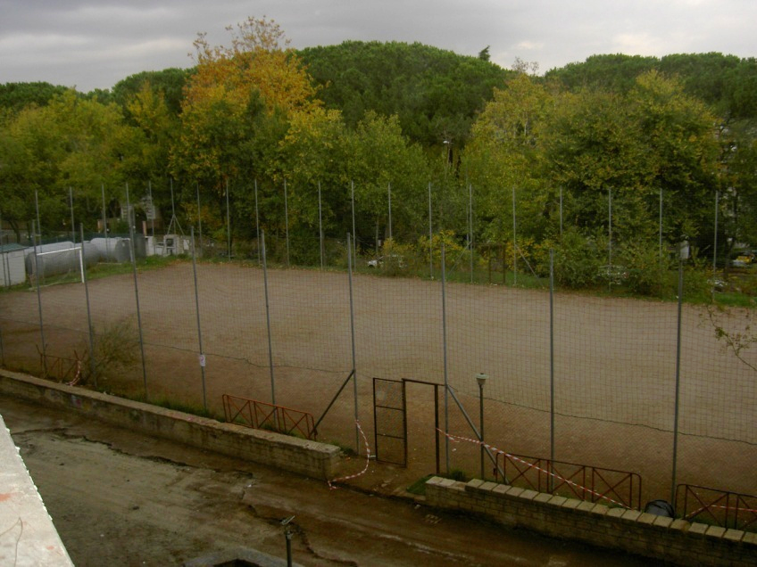
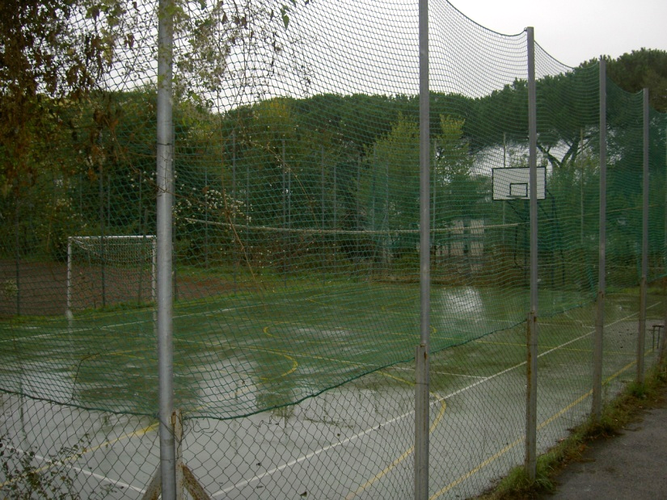
The gym and the sports fields
The gym and the sports fields are used every day by students for gymnastics and school tournaments.

Slide 6
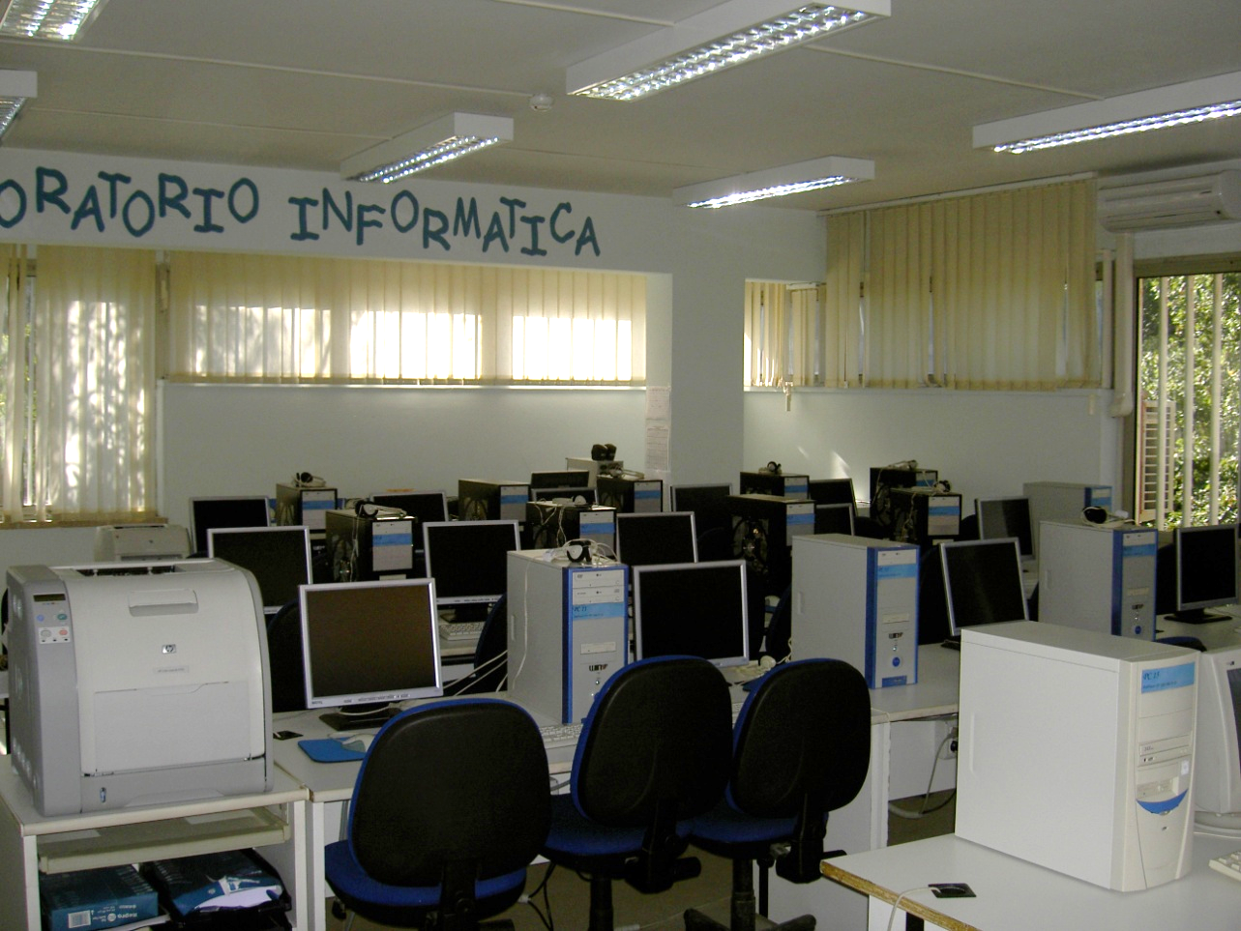
The computer lab
The Computer lab is used for a variety of activities:
presentation of math procedures
use of programming languages to create software programs for the solution of Math problems
foreign languages interactive lessons and different training courses.

Slide 7
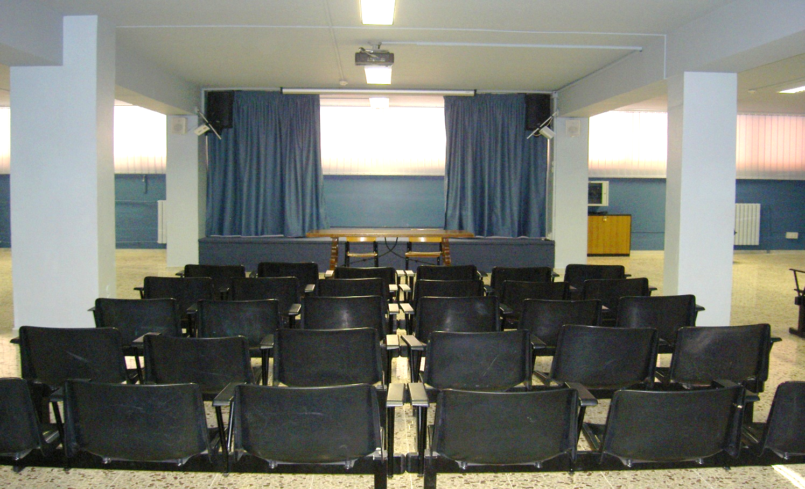
The Aula Magna
The Aula Magna (Assembly hall) in addition to its function as a conference room, is used as a theatre and video room being equipped with sound system, projector and screen.

Slide 8
Photovoltaic Panels The 42 photovoltaic panels installed on our school roof produce 6Kwp and they cover one third of the school energy requirements

Slide 9
Thank you for watching, and … arrivederci a Roma!

